Slide 1
Distributed System System that consists of several computers that communicate with each other exchanging messages over a communication network and each computer has its own memory and runs it own OS.
Local resource: the resources owned and controlled by a computer are said to be local to it.
Remote resource: the resources owned and controlled by other computers and those that can only be accessed through the network are said to be remote

Slide 2
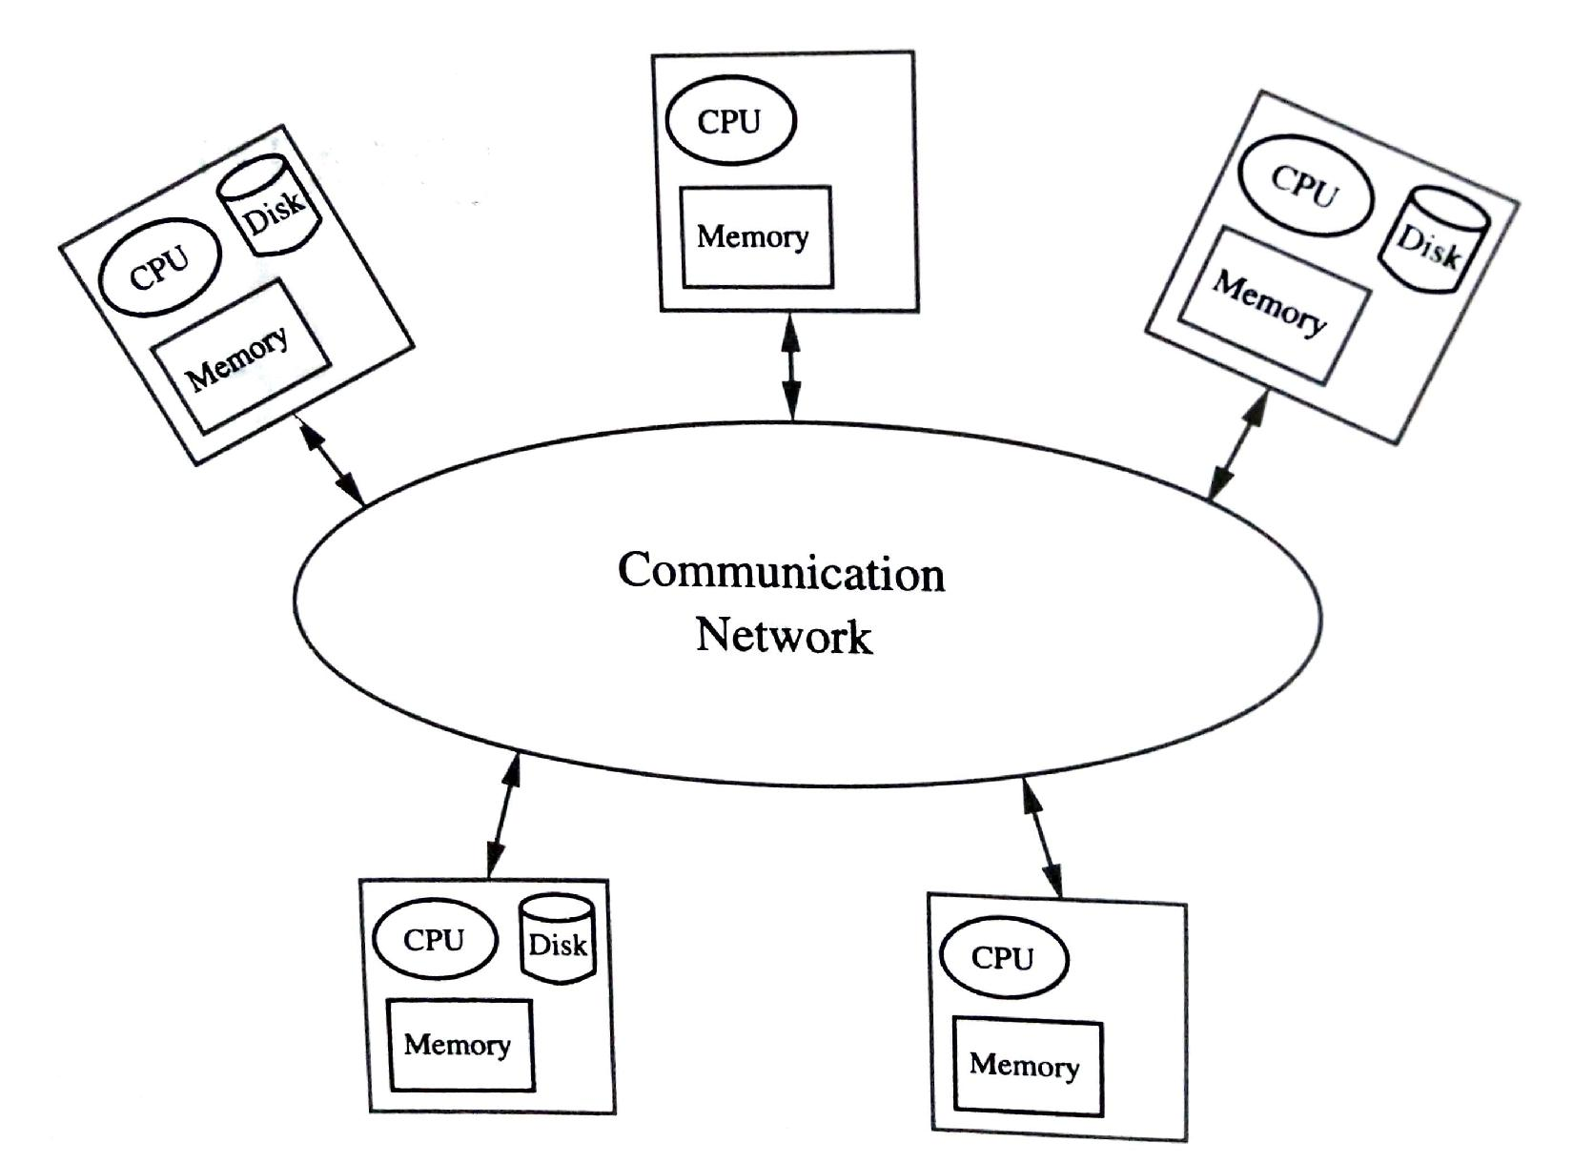
Fig. Architecture of a distributed system

Slide 3
Motivation
availability of powerful microprocessor as low cost
significant advances in communication technology
Advantages of Distributed systems over traditional time-sharing systems
Resource sharing
Enhanced performance
Improved reliability and availability
Modular expandability

Slide 4
System architecture types
Tanenbaum and Renesse classified distributed systems into three broad categories:
Minicomputer model
-Ratio of the no. of processors to the no. of users is normally <1
Workstation model
-Ratio of the no. of processors to the no. of users is normally =1
Processor pool model
-Ratio of the no. of processors to the no. of users is normally >1

Slide 5
Distributed OS(DOS)
A DOS extends the concepts of resource management and user friendly interface for shared memory computers a step further, encompassing a distributed computing system consisting of several autonomous computers connected by a communication network.

Slide 6
Issues in DOS
Global knowledge
Naming
Scalability
Compatibility
Process synchronization
Resource management
-Data migration
-Computation migration
- Distributed scheduling
Security
Structuring
-The Monolithic Kernel
-The Collective Kernel Structure
-Object Oriented OS
Client-Server Computing Model

Slide 7
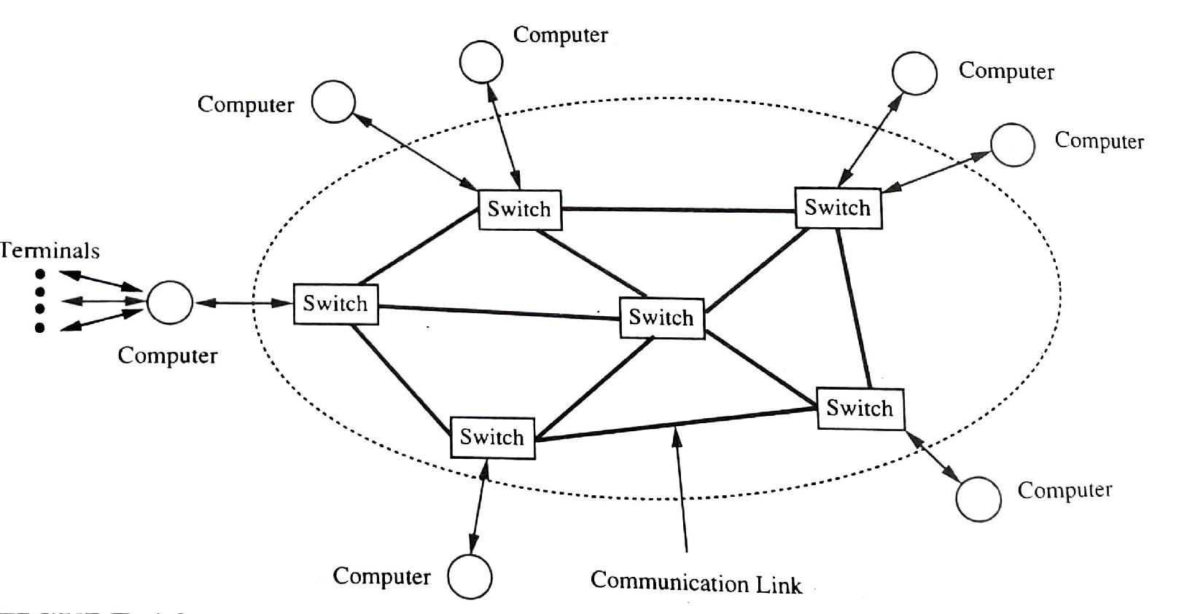
Communication Networks
WAN
Fig. A point-to-point network

Slide 8
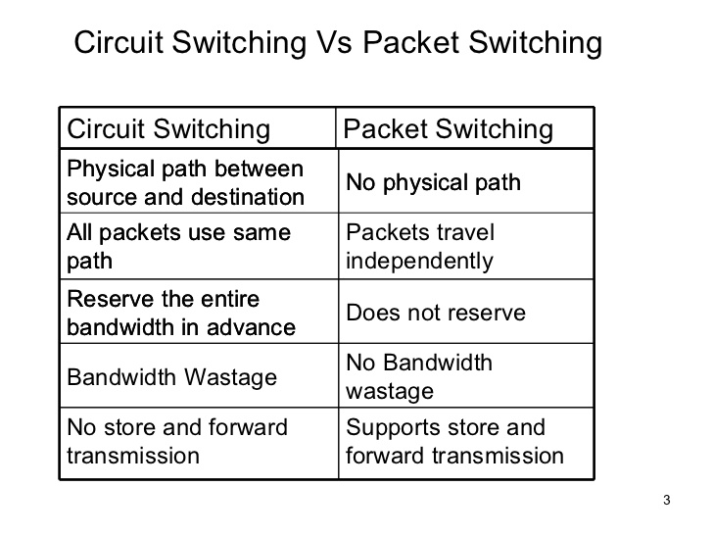

Slide 9
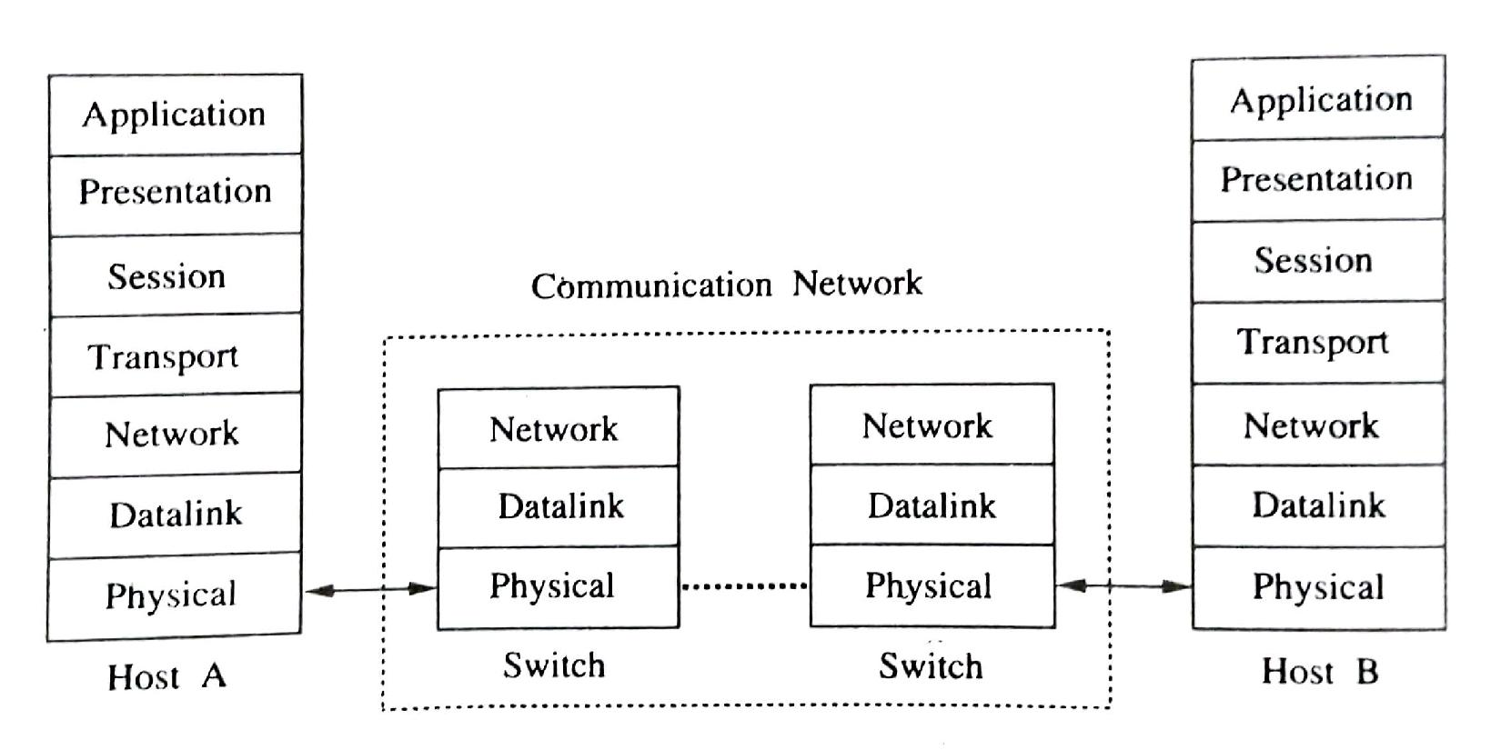
ISO OSI Reference Model

Slide 10
Overview of the ISO OSI Layers
Physical Layer
allow a device to send raw bit stream of data over the communication network
not concerned with transmission errors, how bits are organized or what they mean
aware and take care of the communication network implementation details like circuit/packet switching, type of network(telephone system, digital transmission, etc.)

Slide 11
Data Link Layer
responsible for recovering from transmission errors and flow control (takes care of any disparity between the speeds at which the bits can be sent and received)
makes the communication facility provided by the physical layer reliable
Network Layer
mainly responsible for routing and congestion control
breaks a message into packets and decide which outgoing line will carry the packets toward their destination

Slide 12
Transport Layer
primary function is to hide all the details of the communication network from the layers above
provides a network independent device-to-device (end-to-end) communication
can provide the ability to the network to inform a host that the network has crashed or has lost certain packets
This layer can provide improved reliability if necessary.
Session Layer
responsible for establishing and maintaining a connection known as session between two processes
may keep track of the outstanding requests and replies from processes and order them in such a manner to simplify the design of user programs

Slide 13
Presentation Layer
interface between a user program and the rest of the network
provides data transmission utilities to take care of the differences in representing information at the source and at the destination
may perform data compression, encryption and conversion to and from network standards for terminals and files
Application Layer
provide a facility for the user processes to use the ISO OSI protocols

Slide 14
Local Area Networks(LANs)
Some of the key characteristics of LANs:
high data transmission rates(10 – 100 Mbps)
small geographic scope, generally confined to a single building or perhaps several buildings(such as a college campus)
low transmission error rate

Slide 15
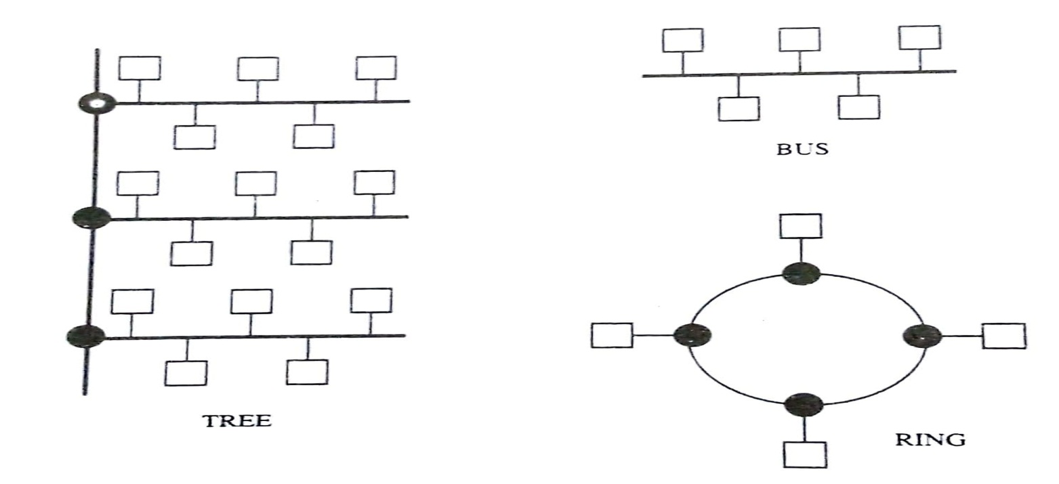
Fig. Network topologies
Widely used network topologies for LANs are bus, ring and tree.
The communication media can be coaxial cable, twisted pair wire or optical fiber.

Slide 16
Bus/Tree Topology
In Bus topology the communication devices transmit data in the form of packets(contains the address of the destination and message).
Tree topology LAN obtained by interconnecting many bus topology LANs to a common bus.
Bus topology LANs can be viewed as branches of a tree.
Two protocols to control access to the bus:
CSMA/CD(Carrier Sense Multiple Access with Collision Detection)
Token bus

Slide 17
Ring Topology
Ring is physical, data is transmitted point-to-point. At each point the address on the packet is copied and checked to see if the packet is meant for the device connected at that point. If match the rest of the packet is copied otherwise the entire packet is retransmitted to the next device on the ring.
Access control protocol to control access to ring:
The token ring protocol
The slotted ring protocol

Slide 18
The token ring protocol:
A token is circulated around the ring
Token is labeled free when no device is transmitting
When a device wishes to transmit it waits for the token to arrive, labels the token as busy on arrival and retransmits the token
Immediately following the release of the token the device transmits data
The transmitting device will mark the token as free when the busy token returns to the device and the device has completed its transmission

Slide 19
Advantage:
It is not sensitive to the load on the network, the entire bandwidth of the medium can be utilized.
Disadvantage:
Complexity
Token has to be maintained error-free
If token is lost care must be taken to generate only one token
The maintenance of the token may require a separate process to monitor it

Slide 20
The slotted ring protocol
A number of fixed length slots continuously circulate around the ring. The ring is like a conveyor belt.
A device wishing to transmit data waits for a slot marked empty to arrive, marks it full and inserts the destination’s address and the data into the slot as it goes by.
The device is not allowed to retransmit again until this slot returns to the device, at which time it is marked as empty by the device.
After the newly emptied slot continues on, the device is again free to transmit data.
A few bits are reserved in each slot so that the result of the transmission(accepted, busy or rejected) can be returned to the source.

Slide 21
Advantage:
Simplicity
Disadvantage:
Wasted bandwidth. When the ring is not heavily utilized, many empty slots will be circulating, but a particular device wishing to transmit considerable amounts of data can only transmit once per round-trip ring time.

Slide 22
Communication Primitives
High level constructs with which programs use the underlying communication network. They play a significant role in the effective usage of distributed systems. It influence a programmer’s choice of algorithms as well as ultimate performance of the programs.
Two communication models, namely, message passing and remote procedure call, that provide communication primitives.

Slide 23
Message Passing Models:
This model provides two basic communication primitives
SEND
RECEIVE

Slide 24
Remote Procedure Calls(RPC):
In message passing model programmers must handle the following details:
pairing of responses with request messages
data representation (when computers of different architectures or programs written in different programming languages are communicating)
knowing the address of the remote machine or the server
taking care of communication and system failures

Slide 25
Contd.
RPC mechanisms hide all the details from programmers.
It based on the observation that procedure call is a well known and well understood mechanism for transfer of control data within a program running on a single computer.
The RPC mechanism extends this same mechanism to transfer control and data across a communication network.
It can be viewed as an interaction between a client and a server where the client needing a service invokes a procedure at the server.

Slide 26
Contd.
Basic RPC operation:
On invoking a remote procedure the calling process (client) is suspended and parameters if any are passed to the remote machine (server) where the procedure will execute.
On completion of the procedure execution the results are passed back from the server to the client and the client resumes execution as if it had called a local procedure.

Slide 27
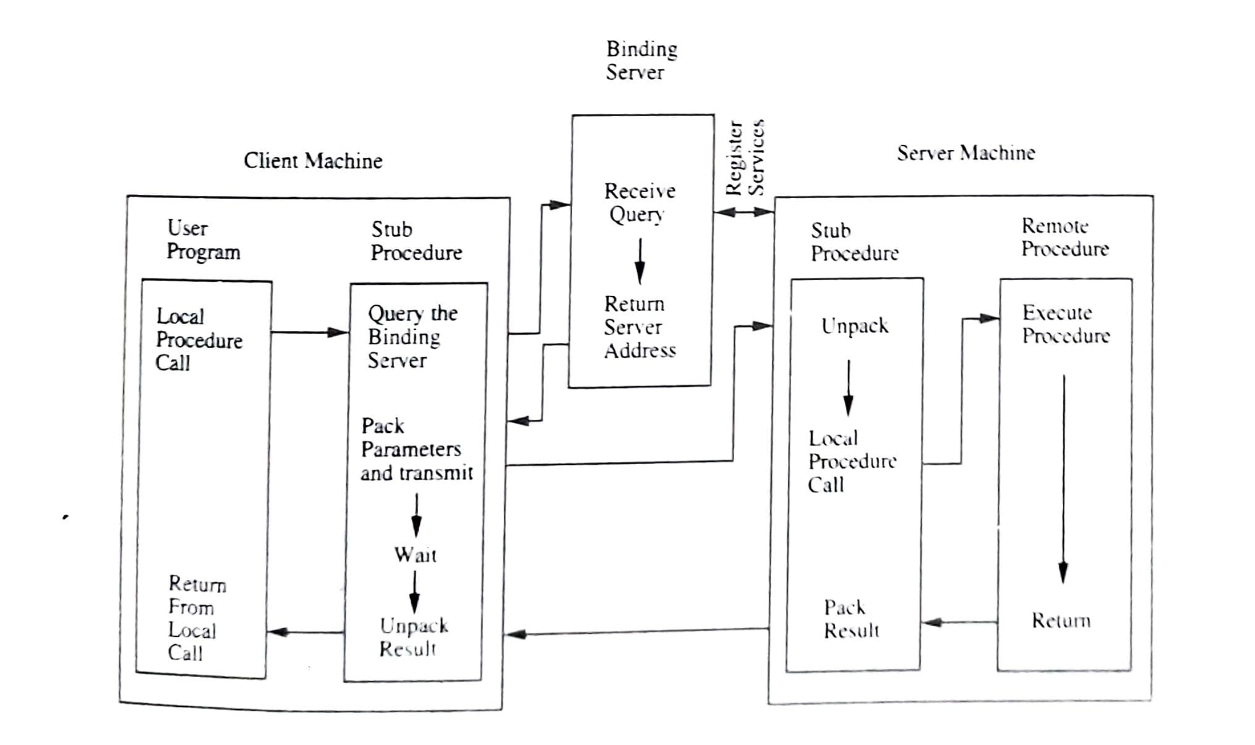
Fig. Remote procedure call

Slide 28
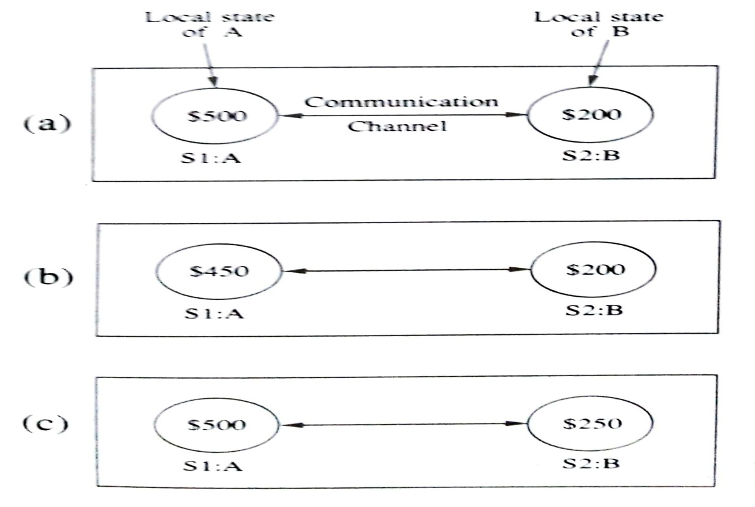
Inherent Limitations of a Distributed System
Absence of a Global Clock
Absence of shared memory
Fig. A distributed system with two sites

Slide 29
Lamport’s Logical Clocks
Happened Before Relation(→):
The happened before relation captures the causal dependencies between events i.e. whether two events are causally related or not. The relation →is defined as follows:
a →b, if a and b are events in the same process and a occurred before b
a →b, if a is the event of sending a message m in a process and b is the event of receipt of the same message m by another process
if a→b and b→c, then a→c, i.e. “→”relation is transitive

Slide 30
Causally Related Events
Event a causally affects event b if a→b
Concurrent events: two distinct events a and b are said to be concurrent (denoted by a||b) if a→b and b→a. In other words concurrent events do not causally affect each other.
For any two events a and b in a system either a→b, b→a or a||b.

Slide 31
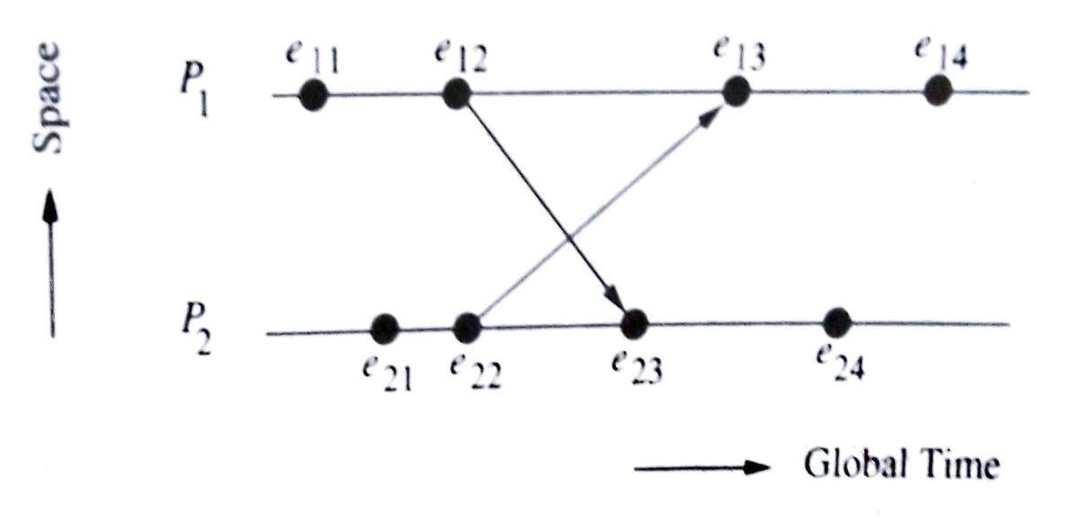
Contd.
Fig. A space-time diagram
Let e₁₁,e₁₂,e₁₃, and e₁₄ are events in process P₁ and e₂₁,e₂₂,e₂₃ and e₂₄ are events in process P₂. The arrows represent message transfers between the processes. For ex. arrow e₁₂e₂₃ corresponds to a message sent from process P₁ to process P₂. e₁₂ is the event of sending the message at P₁ and e₂₃ is the event of receiving the same message at P₂. In the above figure e₂₂→e₁₃, e₁₃→e₁₄ and therefore e₂₂→e₁₄. In other words, event e₂₂ causally affects event e₁₄.

Slide 32
Logical clocks
In order to realize the relation → Lamport introduced system of logical clocks. There is a clock C_{i} at each process P_{i} in the system. The clock C_{i} can be thought of as a function that assigns a number C_{i} (a) to any event a, called the timestamp of event a, at P_{i} . The numbers assigned by the system of clocks have no relation to physical time and hence the name logical clocks. The timestamp of an event is the value of the clock when it occurs.

Slide 33
Contd.
Conditions satisfied by the system of clocks:
For any events a and b:
If a→b, then C(a)<C(b)
The happened before relation ‘→’ can now be realized by using the logical clocks if the following two conditions(correctness conditions) are met:
[C1] for any two events a and b in a process P_{i}, if a occurs before b, then
C_{i}(a) < C_{i}(b)
[C2] if a is the event of sending a message m in process P_{i} and b is the event of receiving the same message m at process P_{j}, then
C_{i}(a) < C_{j}(b)

Slide 34
Contd.
The following implementation rules (IR) for the clocks guarantee that the clocks satisfy the correctness conditions [C1] and [C2]:
[IR1] Clock C_{i} is incremented between any two successive events in process P_{i}:
C_{i}:= C_{i}+d (d>0)
If a and b are two successive events in P_{i} and a→b, then C_{i}(b)=C_{i}(a)+d (d>0) [1.1]

Slide 35
Contd.
[IR2] If event a is the sending of message m by process P_{i}, then message m is assigned a timestamp t_{m}=C_{i}(a) (note that the value of C_{i}(a) is obtained after applying IR1). On receiving the same message m by process P_{j}, C_{j} is set to a value greater than or equal to its present value and greater than t_{m}.
C_{j} : max((C_{j}, t_{m} +d) (d>0) [1.2]

Slide 36
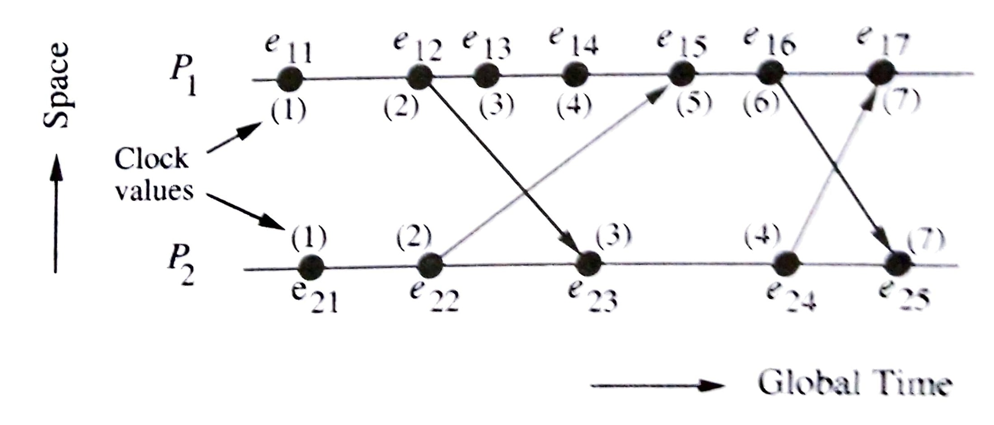
Contd.
Fig. How Lamport’s logical clocks advance
Let both the clock values C_{P1} and C_{P2} are assumed to be zero initially and d is assumed to be 1. e₁₁ is an internal event in process P1 which causes C_{P1} to be incremented to 1 due to IR1. Similarly e₂₁ and e₂₂ are two events in P₂ resulting in C_{P2}=2 due to IR1. e₁₆ is a message send event in P₁ which increments C_{P1} to 6 due to IR1. The message is assigned a timestamp =6 . The event e₂₅ corresponding to the receive event of the above message, increment the clock C_{P2} to 7(max(4+1,6+1)) due to rules IR1 and IR2. Similarly, e₂₄ is a send event in P₂. The message is assigned a timestamp=4. The event e₁₇ corresponding to the receive event of the above message increments the clock C_{P1} to 7 (max(6+1, 4+1)) due to rules IR1 and IR2.

Slide 37
Contd.
Virtual time:
Lamport’s system of logical clocks implements an approximation to global/physical time, which is referred to as virtual time. Virtual time advances along with the progression of events and is therefore discrete. If no events occur in the system, virtual time stops, unlike physical time which continuously progresses.

Slide 38
Contd.
Limitation of Lamport’s clocks
In lamport’s system of logical clocks, if a→b then C(a)<C(b). However, the reverse is not necessarily true if the events have occurred in different processes. That is if a and b are events in different processes and C(a)<C(b), then a→b is not necessarily true, events a and b may be causally related or may not be causally related. Thus Lamport’s system of clocks is not powerful enough to capture such situations.

